Slide 1


Slide 2
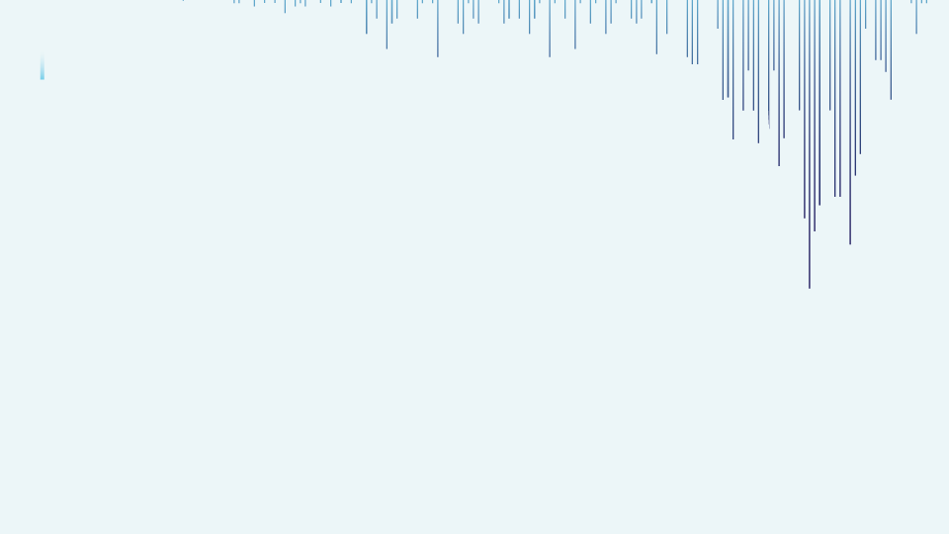

Store Sales Prediction
Presented By :
Ronak Jain

Slide 3
Project Contents
Introduction and Problem Statement
Read Data
Data Exploration
Check for Unique and Duplicate Values
Data Visualization
Splitting Data
Modeling
Conclusion

Slide 4
Introduction and Problem Statement
A crucial part of store management is estimating sales, and machine learning can assist in identifying the variables that affect a retail store's sales as well as projecting future sales figures. This presentation uses a Walmart past sales data to forecast its sales ahead of its time.
Problem Statement:
The objective of this experimental approach is to develop a robust store sales prediction model capable of predicting future sales within an effective modelings.

Slide 5
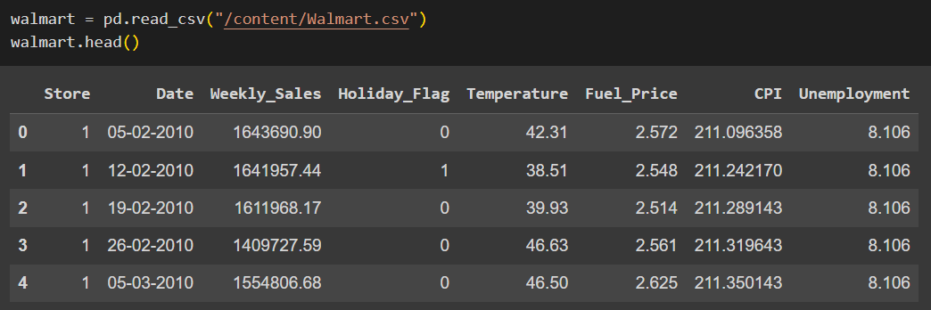
Read Data
Import the necessary libraries for data analysis and visualization
Reading a CSV file located at the specified path and assigning it to a pandas DataFrame called ‘walmart’.
Head Function displays the initial rows of a DataFrame, providing a quick overview of its structure and content.
Tail function shows the last few rows of a DataFrame, offering a glimpse of the DataFrame's structure and content at the end.

Slide 6
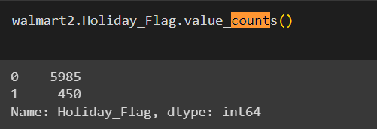
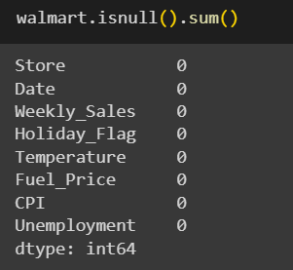
Data Exploration
Info function is useful for quickly understanding the overall structure of the DataFrame and identifying any missing or inconsistent data.
value.counts() function calculates the count of unique values in the 'isFraud' column. Dataset is imbalanced, with the majority class (non-fraudulent) significantly outnumbering the minority class (fraudulent).
Isnull function provides a count of null values in each column of the DataFrame.

Slide 7
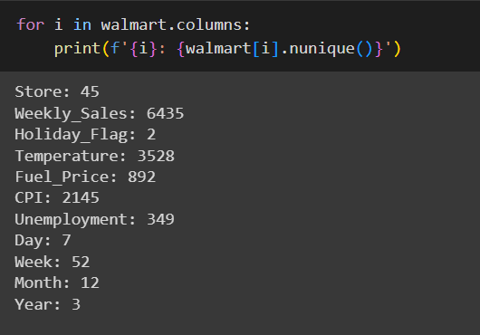
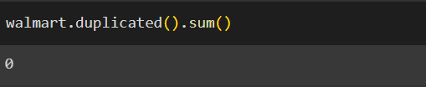
Checking for Unique and Duplicate Values
nunique() function returns a Series object that displays the count of unique values for each column.
Dataset does not contain any duplicate values.

Slide 8
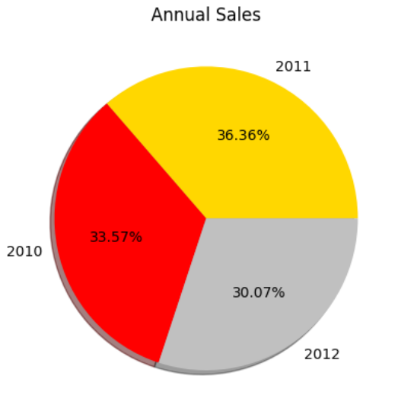
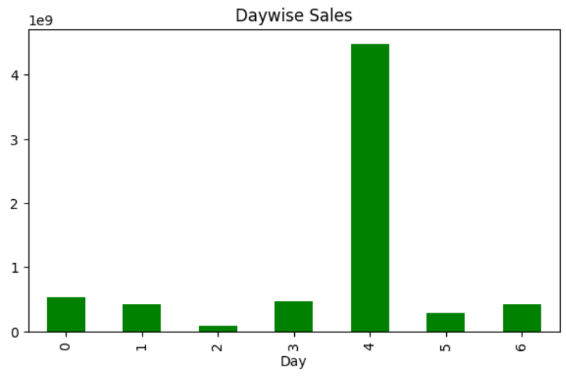
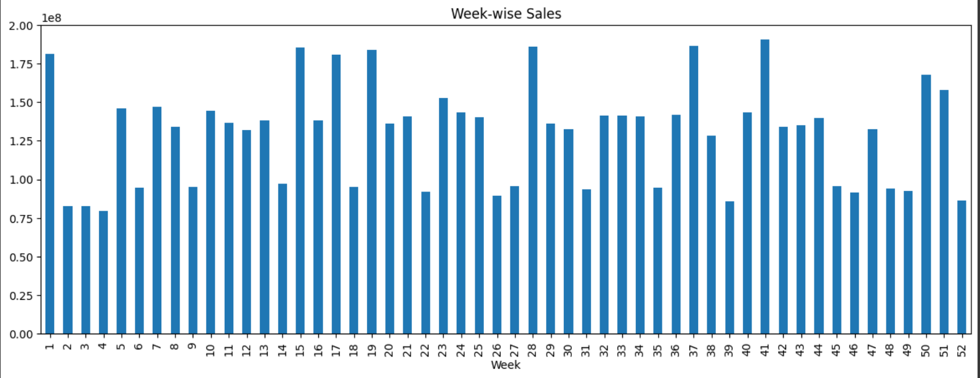
Data Visualization (Visualizing sales distribution in different timezones )
Year 2011 has highest sales followed by 2010 and 2012.
Thursday has maximum sales in a week.
41st week has highest sale in a year

Slide 9
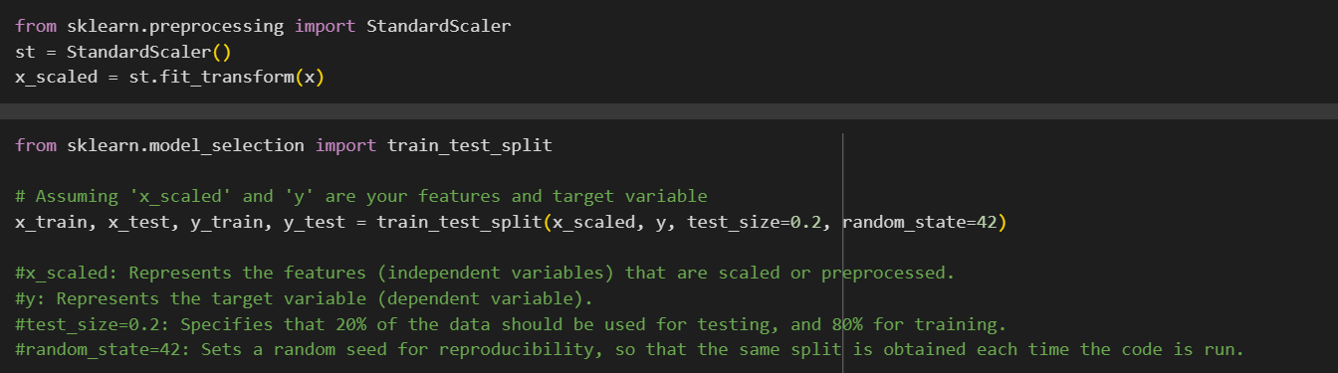
Scaling Values & Splitting Data
Scaling is performed to ensure that all numerical features in a dataset are on a similar scale, avoiding biases, enabling fair comparisons, and facilitating the convergence of machine learning algorithms for better model performance.
This code randomly splits the dataset x and y into two separate sets:
#x_scaled: Represents the features (independent variables) that are scaled or preprocessed.
#y: Represents the target variable (dependent variable).
#test_size=0.2: Specifies that 20% of the data should be used for testing, and 80% for training.
#random_state=42: Sets a random seed for reproducibility, so that the same split is obtained each time the code is run.

Slide 10
Modeling
Models used :
Linear Regression : Linear regression analysis is used to predict the value of a variable based on the value of another variable.
2. Decision Tree : Decision trees can effectively handle non-linear relationships between features.Sales prediction and patterns may not follow a linear trend, and decision tree can capture complex interactions and non-linear decision boundaries,making them suitable for detecting sales.
3. Random Forest : Random Forest can handle imbalanced data well by assigning weights to the minority class or using techniques like bootstrapping and feature sampling.This helps in mitigating the class imbalance problem and improving the model’s ability to detect sales.
Gradient Boosting: Gradient Boosting is an ensemble technique. It is primarily used in classification and regression tasks.
In our dataset , Random Forest proves to be the most effective model giving an accuracy of 95%.

Slide 11
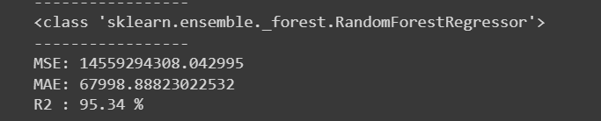
Model Comparison
Selection of Model:
After evaluating different models for store sales prediction, including Linear Regression, Decision Tree, Random Forest, and Gradient Boosting, it can be concluded that the Random Forest models outperform the others with a high accuracy score of 95.34%.
Random Forest is an ensemble learning method that combines multiple decision trees. It can handle complex interactions between features and has the advantage of being less prone to overfitting. Random Forest can be effective in identifying fraudulent patterns in the data.
Random Forest is an ensemble learning method that combines multiple decision trees. It can handle complex interactions between features and has the advantage of being less prone to overfitting.
This ensemble approach helps in reducing overfitting and improving the generalization performance of the model. By aggregating predictions from multiple trees, Random Forest can capture different aspects of the data and make more accurate predictions.

Slide 12
Conclusion
Several conclusions from Walmart's sales prediction analysis were drawn from the examination of sales data.
The conclusions made from the sales prediction study give Walmart useful information that it may use to improve decision-making, sales tactics, inventory management, and marketing initiatives in order to better serve customers and increase sales.
Based on the provided dataset, Random Forest turns out to be the most promising model for predicting sales.

Slide 13
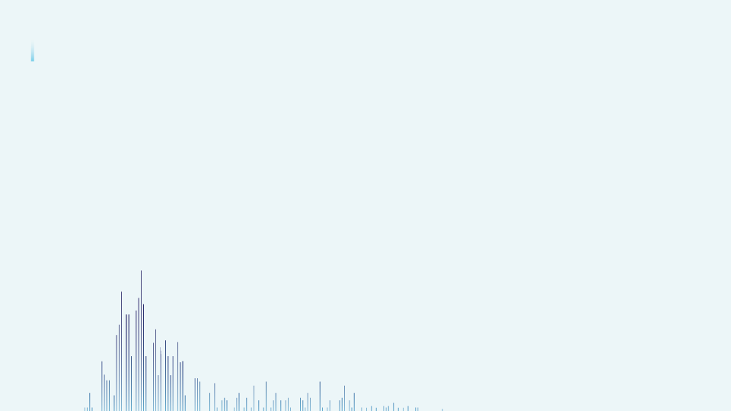
THANK YOU !

